Slide 1

Seasonal Agriculture Performance Analysis
Athul A Dev
University college of engineering kariavatoom
AICTE STU ID : STU6a67a4e6b0c3e1785177318

Slide 2

PROBLEM STATEMENT
(Agricultural activities are influenced by seasonal variations in environmental conditions, farming practices, resource availability and market conditions. As a result, agricultural performance may differ from one season to another. However, raw agricultural data does not clearly explain how agricultural performance changes across seasons or what patterns can be observed in different seasonal conditions. The problem is to analyze the given agricultural dataset and investigate seasonal differences in agricultural performance by identifying meaningful patterns, trends, relationships and variations within the available data.

Slide 3
Project Description
Seasonal Agriculture Performance Analysis is a data analytics project that studies how agricultural performance varies across different seasons. The project analyzes crop yield, production, environmental conditions, resource usage, irrigation methods, economic performance, and disease/pest risk to identify important seasonal patterns and relationships. Data visualization and statistical techniques are used to compare seasons and discover significant differences. The analysis also provides evidence-based insights and recommendations for better seasonal agricultural planning.

Slide 4

WHO ARE THE END USERS?
Farmers – to understand seasonal crop performance and improve farming decisions.
Agricultural Departments & Government Agencies – for seasonal planning and policy decisions.
Agricultural Researchers – to study relationships between environmental factors and crop outcomes.
Agribusiness & Agricultural Planners – to analyze production, costs, prices, and profitability.
Resource Management Authorities – to improve water, fertilizer, and pesticide utilization.

Slide 5

Technology Used
Python – Main programming language for data analysis
Google Colab – Development and execution environment
Pandas & NumPy – Data cleaning and manipulation
Matplotlib & Seaborn – Data visualization
SciPy – Statistical analysis and ANOVA
Scikit-learn – Machine learning and prediction
Random Forest – Crop yield prediction and feature importance
Excel – Exporting and presenting analysis results

Slide 6
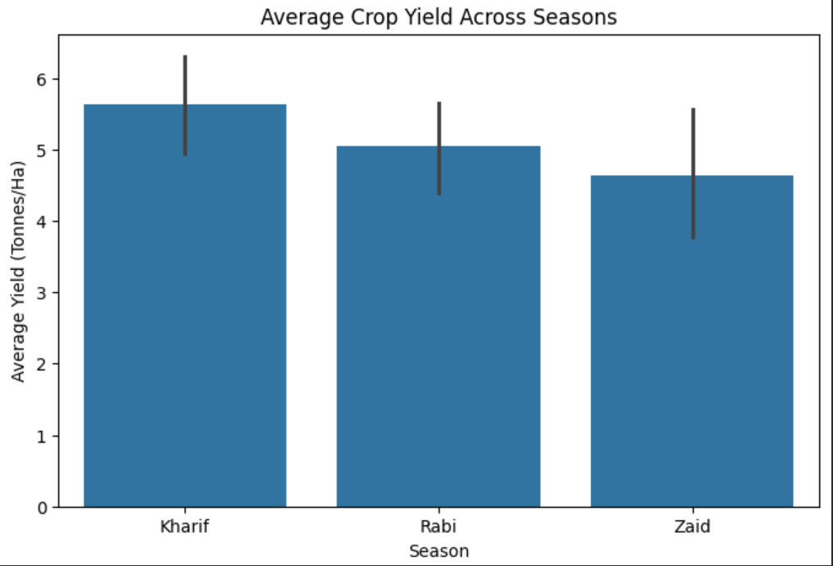
RESULTS
Average crop yield in different agricultural seasons.
Kharif season has the best average crop yield, followed by Rabi, while Zaid has the lowest yield. This indicates that seasonal conditions may have an effect on agricultural productivity.

Slide 7
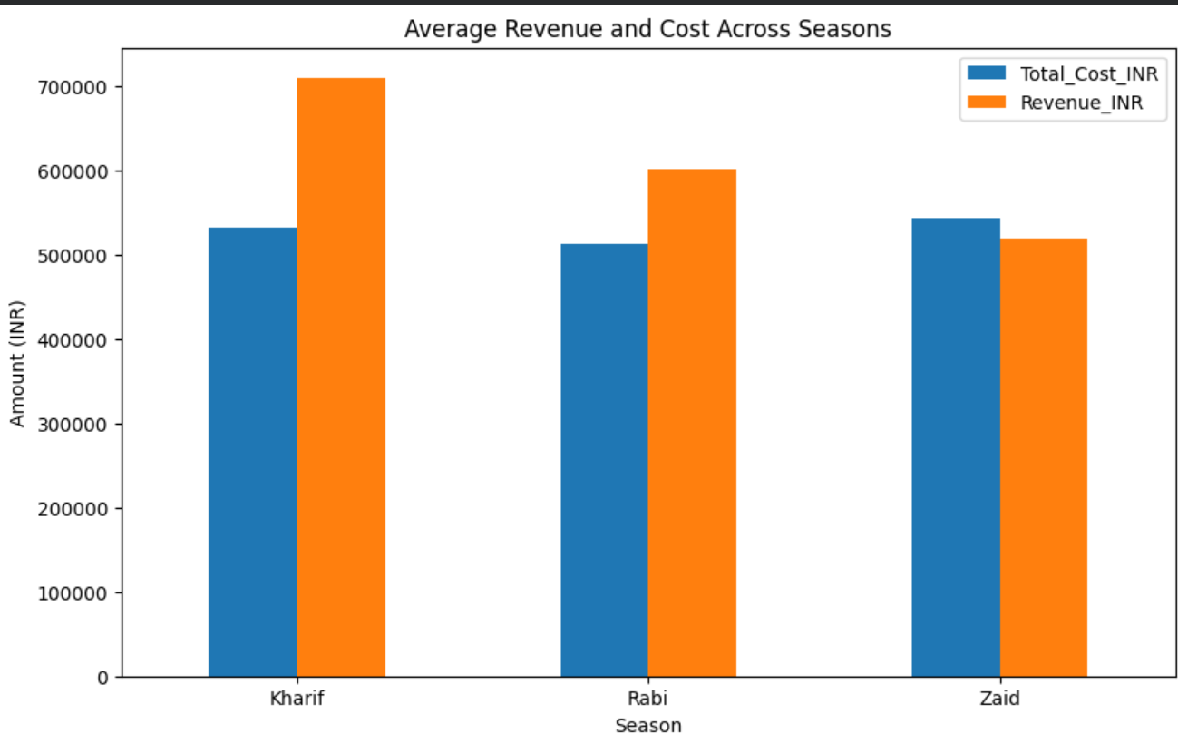
RESULTS
This bar chart compares the Average Total Cost (blue) and Average Revenue (orange) in Indian Rupees (INR) across the three farming seasons: Kharif, Rabi, and Zaid
Production costs remain relatively stable across all three seasons (~₹5.1L to ₹5.4L), but revenue varies sharply. Farmers generate the highest financial return during the Kharif season, while Zaid farming runs at a financial loss under current practices

Slide 8
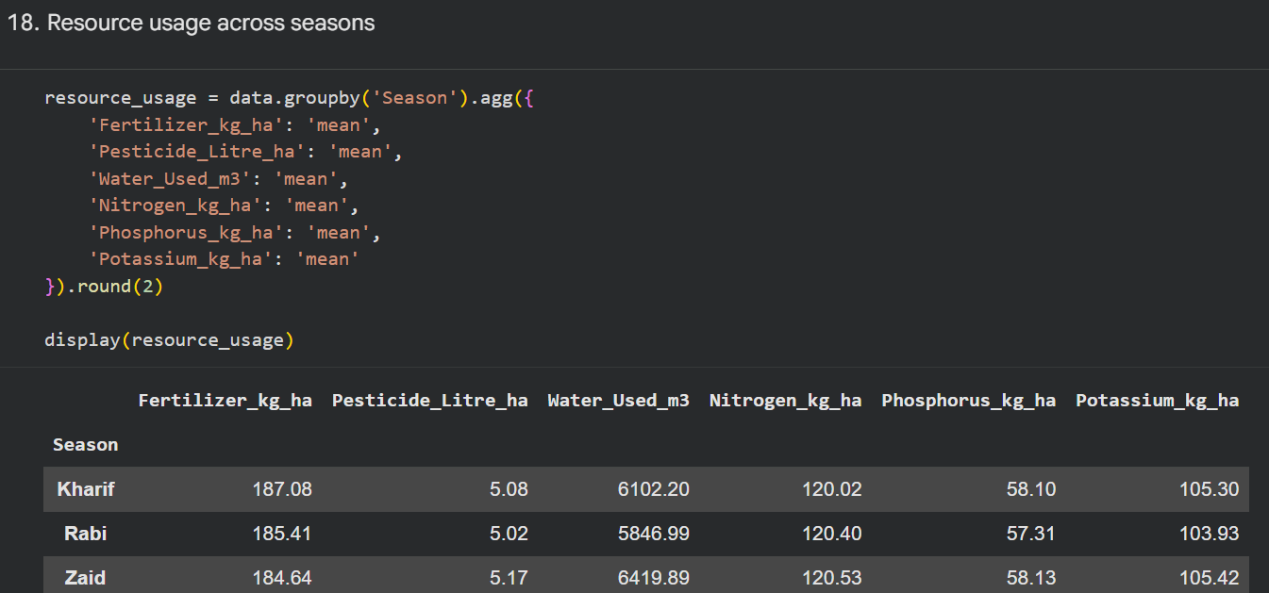
RESULTS
This table shows the average resource consumption per hectare across the three agricultural seasons (Kharif, Rabi, and Zaid)
While chemical inputs (fertilizer, pesticides, and NPK nutrients) are applied at nearly identical rates year-round, water demand varies significantly by season, peaking during the dry summer months of Zaid

Slide 9
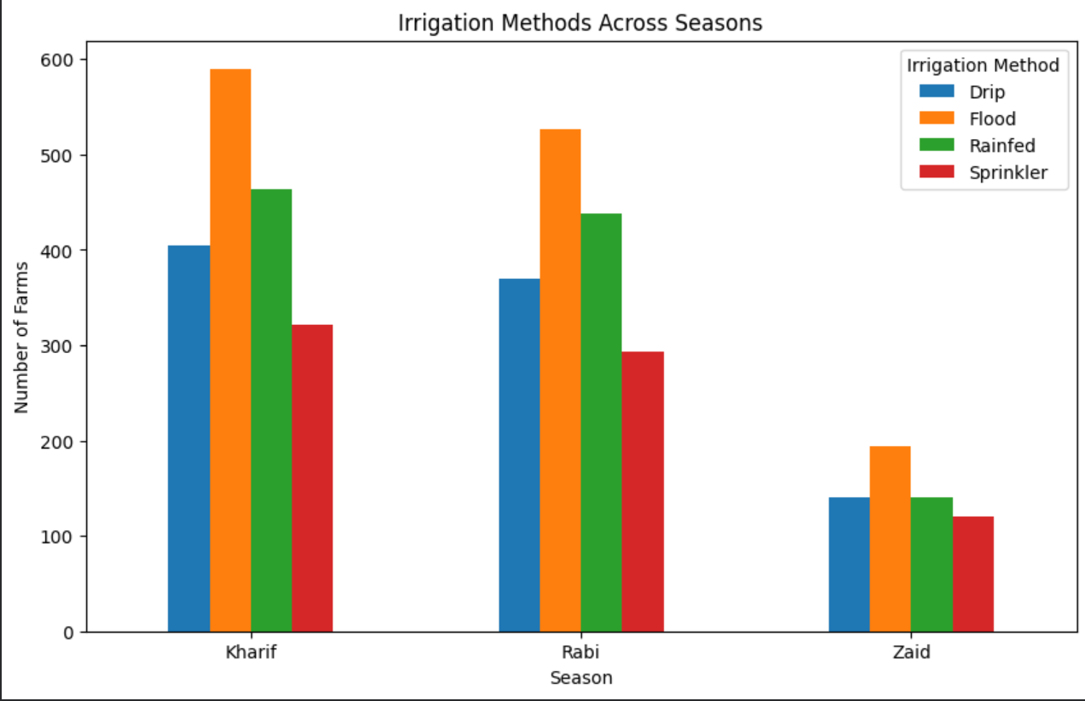
RESULTS
This bar chart shows how many farms use each Irrigation Method (Drip, Flood, Rainfed, and Sprinkler) across the three agricultural seasons: Kharif, Rabi, and Zaid
Flood Irrigation is the Most Popular: In every single season, Flood irrigation (orange bar) is the most widely used technique among farms.
Sprinkler Systems are the Least Used: Across all seasons, Sprinkler irrigation (red bar) consistently has the lowest adoption rate.
Proportional Trends: Although the total number of farming operations drops significantly in the Zaid season, the relative preference for each irrigation method stays roughly the same

Slide 10
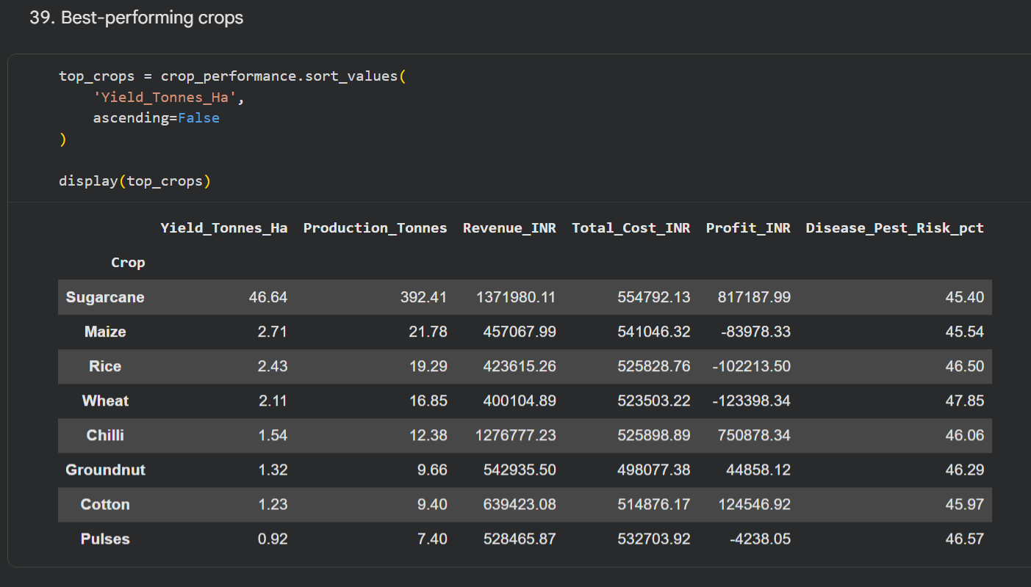
RESULTS
This table summarizes the average performance metrics across different crops, including output yields, production volumes, revenues, costs, profits, and disease risks
Cash crops (Sugarcane and Chilli) drive high profitability due to superior market pricing. In contrast, staple food grains (Wheat, Rice, and Maize) incur similar production expenses but lower market revenue, resulting in average net losses

Slide 11
Future scope
Real-time agricultural monitoring using live weather and soil data.
Advanced AI/ML models for more accurate crop yield prediction.
Crop recommendation systems based on season, soil, and climate conditions.
Weather-based forecasting to predict seasonal risks and crop performance.
Smart irrigation optimization to reduce water consumption.
Early disease and pest detection using machine learning and image analysis.
Interactive dashboards for farmers and agricultural authorities.
Integration with IoT sensors for real-time farm data collection

Slide 12
GitHub Link
https://github.com/AswiniKumar55/-Seasonal-Agriculture-Performance-Analysis-.git

Slide 13

VOIS Course completion certificate -
Course name- Data Visualization

Slide 14
Thank you
.
.

